Slide 1

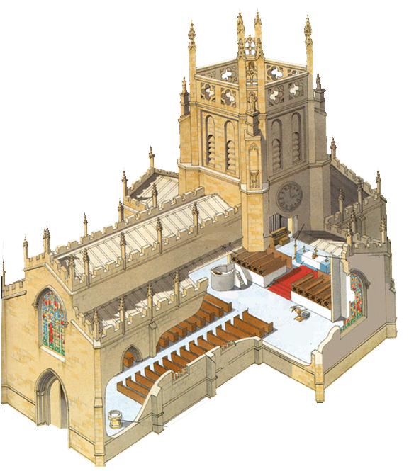
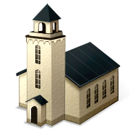
Inside a
Church

Slide 2
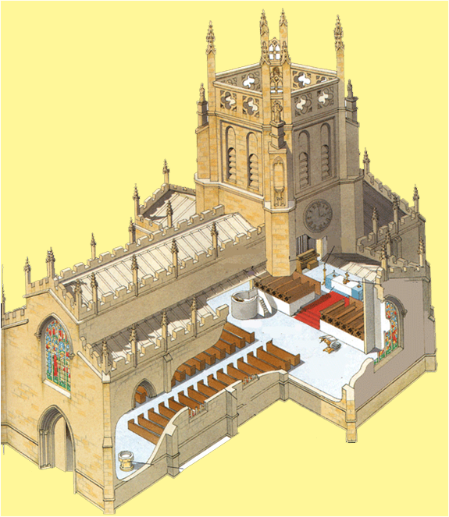
Parts of a Church
The steeple
and bells.
The pulpit. The
preacher talks here
The church
organ.
The pews where
the public sit.
The altar.
Seats for the
church choir
The main entrance is
often at the west.
Stained glass window.

Slide 3
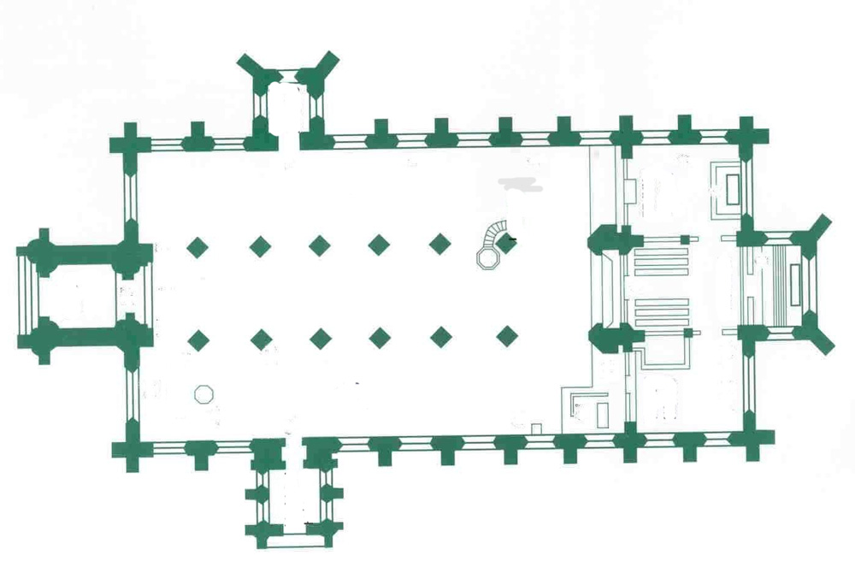
Bird’s Eye View of a
Typical Church
Clergy Vestry
North Aisle
Pulpit
Choir
Altar
West Porch
South Aisle
Font
Lectern
South Porch

Slide 4
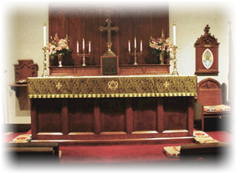
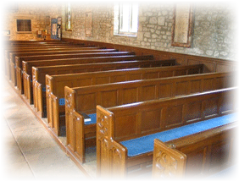
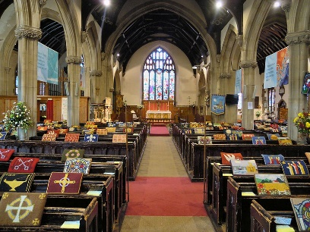
Inside a Church
The main focus inside a church is the altar or holy table.
There are rows of chairs or benches in the middle of the church, facing the altar. These are called pews. You might see hassocks on the pew. Theseare small, padded rectangular boxes with no legs which some Christians groups use in church to rest their knees, usually to pray.

Slide 5
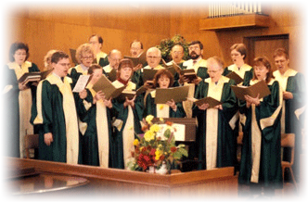
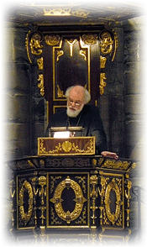
Inside a Church
The priest preaches to the church from the pulpit.
The choir often sit at their own pews, away from the congregation.

Slide 6
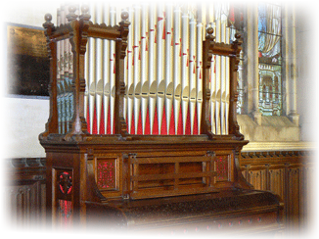
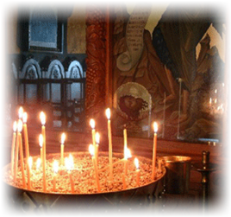
Inside a Church
Most churches have an organ, often near the front, or high up at the rear of the church.
Churches have many candles which are lit during services. The smoke is said to rise like prayers to heaven.

Slide 7
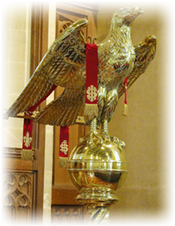
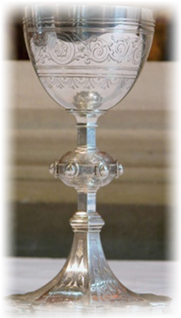
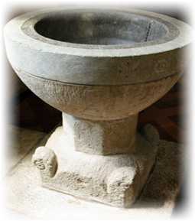
Inside a Church
This is a lectern. The Bible is put on the lectern for people to read from.
This is a chalice. The wine for communion is put in this special cup.
This is the font. Babies get baptised with water from the font.

Slide 8
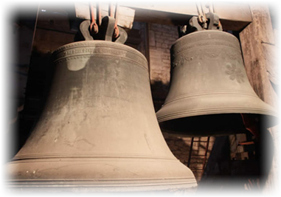

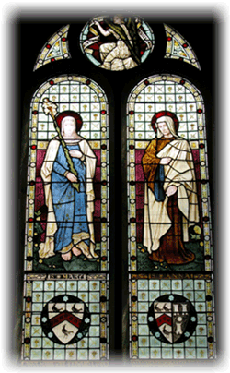
The stained glass windows often tell a story from the Bible.
Inside a Church
Church bells are rung on special occasions or to tell people to come to church.

